Slide 1
Rainbow
NIST Internal Presentation by Ray Perlner
Not for Distribution

Slide 2
(GeMSS and) Rainbow

Slide 3
A Brief Summary
GeMSS (Alternate) is extremely broken
  Major Design Features (the v and (-) modifiers of HFEv- do not provide security)
  To compensate modifications making GeMMS orders of magnitude slower would be required
  Almost certainly should be removed from consideration
Rainbow (Finalist) is slightly broken
  A new MinRank attack by Buellens (combined with recent improvements in algorithms for MinRank) breaks the recently tweaked 3rd round parameters for Rainbow
  With an additional fairly small adjustment, parameters would meet security targets
  Nonetheless, it’s worrying that a novel and relatively simple attack was found this late in the process

Slide 4
GeMSS and Rainbow
Commonalities
  Both Multivariate Signature Schemes
  Large public key/ Small signature
Differences
  GeMSS is a big-field scheme based on HFEv-
  Rainbow is a small-field scheme based on UOV
Attacks
  GeMSS is very broken
  Rainbow is a little broken

Slide 5
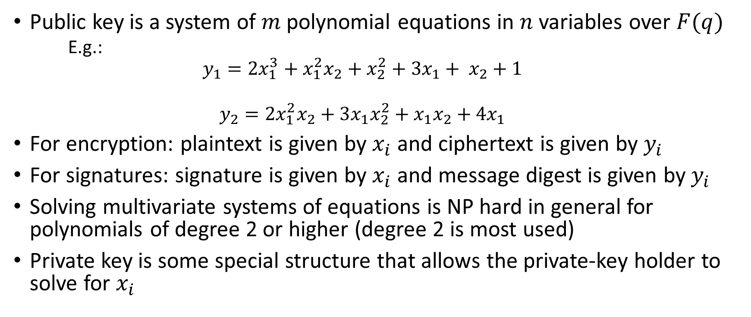
Multivariate Cryptography
Public key is a system of $m$ polynomial equations in $n$ variables over $F(q)$
  E.g.:
  $$y_{1}=2x_{1}^{3}+x_{1}^{2}x_{2}+x_{2}^{2}+3x_{1}+ x_{2}+1$$
  $$y_{2}=2x_{1}^{2}x_{2}+3x_{1}x_{2}^{2}+x_{1}x_{2}+4x_{1}$$
For encryption: plaintext is given by $x_{i}$ and ciphertext is given by $y_{i}$
For signatures: signature is given by $x_{i}$ and message digest is given by $y_{i}$
Solving multivariate systems of equations is NP hard in general for polynomials of degree 2 or higher (degree 2 is most used)
Private key is some special structure that allows the private-key holder to solve for $x_{i}$

Slide 6
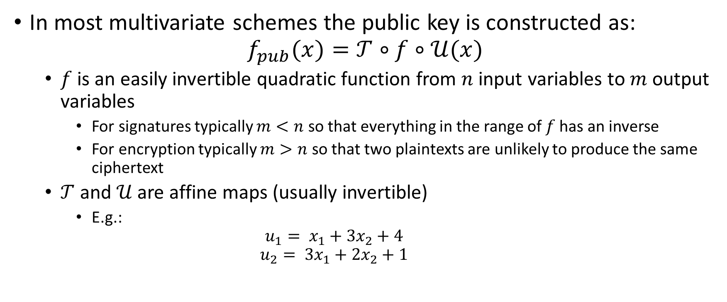
Multivariate Cryptography 2
Butterfly Construction
In most multivariate schemes the public key is constructed as:
$$f_{pub}(x)=𝒯∘f∘𝒰(x)$$
  $f$ is an easily invertible quadratic function from $n$ input variables to $m$ output variables
    For signatures typically $m<n$ so that everything in the range of $f$has an inverse
    For encryption typically $m>n$ so that two plaintexts are unlikely to produce the same ciphertext
  $𝒯$ and $𝒰$ are affine maps (usually invertible)
    E.g.:
    $$u_{1}= x_{1}+3x_{2}+4$$
    $$u_{2}= {3x}_{1}+2x_{2}+1$$

Slide 7
(UOV and) Rainbow

Slide 8
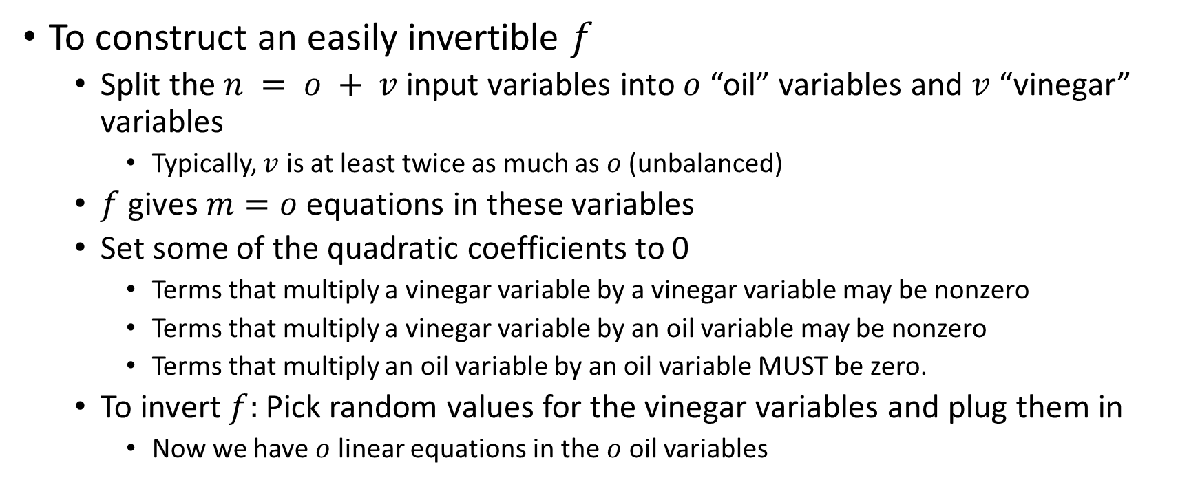
Unbalanced Oil and Vinegar
A Multivariate Scheme Not Vulnerable to MinRank
To construct an easily invertible $f$
  Split the $n = o + v$input variables into $o$ “oil” variables and $v$ “vinegar” variables
    Typically, $v$ is at least twice as much as $o$ (unbalanced)
  $f$ gives $m=o$ equations in these variables
  Set some of the quadratic coefficients to 0
    Terms that multiply a vinegar variable by a vinegar variable may be nonzero
    Terms that multiply a vinegar variable by an oil variable may be nonzero
    Terms that multiply an oil variable by an oil variable MUST be zero.
  To invert $f:$ Pick random values for the vinegar variables and plug them in
    Now we have $o$ linear equations in the $o$ oil variables

Slide 9
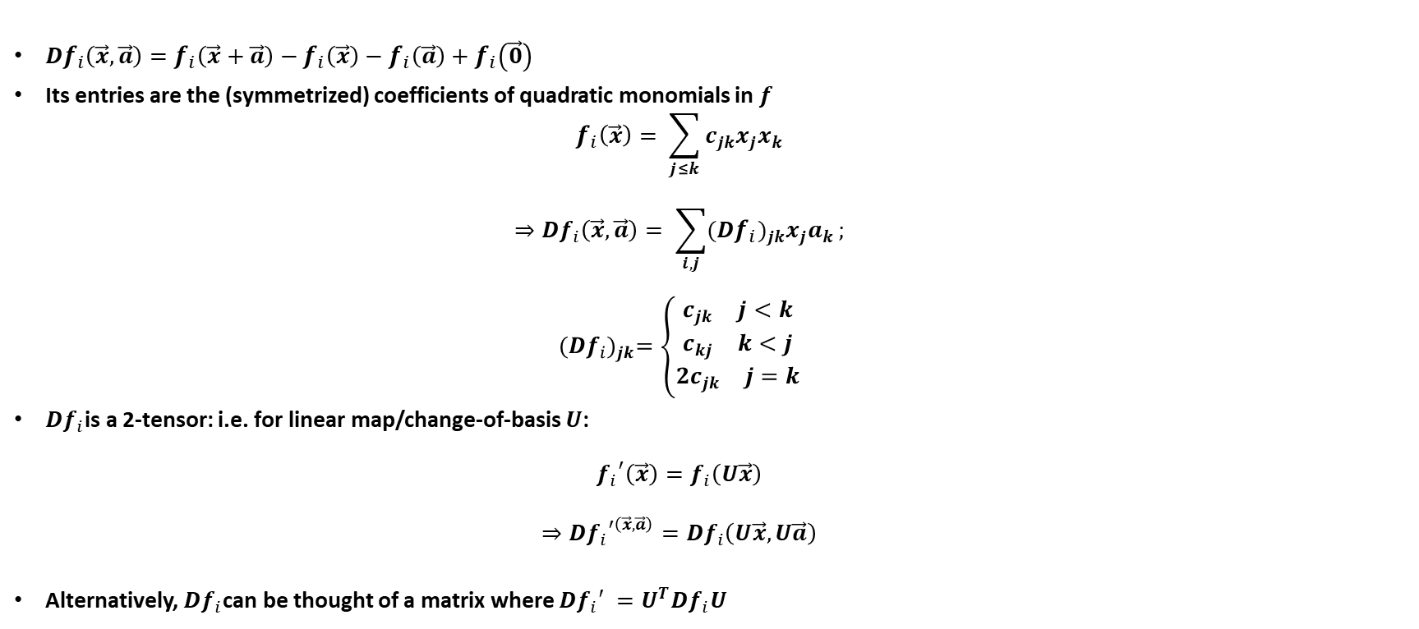
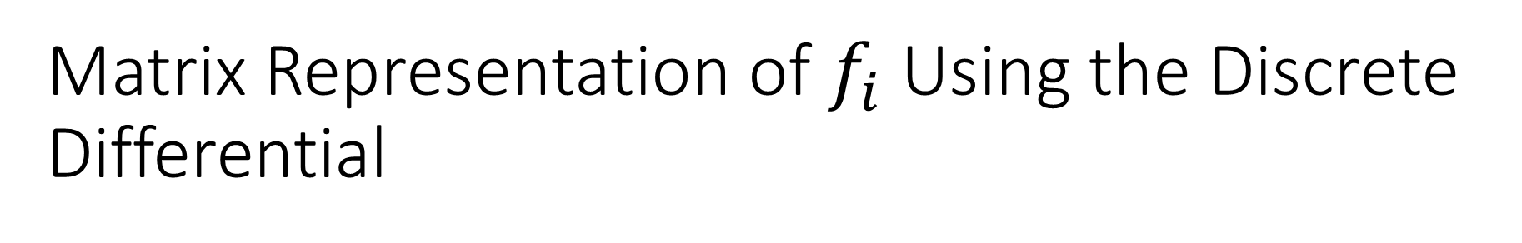
Matrix Representation of $f_{i}$ Using the Discrete Differential
$Df_{i}\left(\vec{x},\vec{a}\right)=f_{i}\left(\vec{x}+\vec{a}\right)−f_{i}\left(\vec{x}\right)−f_{i}\left(\vec{a}\right)+f_{i}\left(\vec{0}\right)$
Its entries are the (symmetrized) coefficients of quadratic monomials in $f$
  $$f_{i}\left(\vec{x}\right)= \sum_{j≤k}{c_{jk}x_{j}x_{k}}$$
  $$⇒Df_{i}\left(\vec{x},\vec{a}\right)= \sum_{i,j}{({Df_{i})}_{jk}x_{j}a_{k}};$$
  $${(Df_{i})}_{jk}=\left\{\begin{matrix}\begin{aligned}\begin{matrix}c_{jk} & j<k\end{matrix} \\ \begin{matrix}c_{kj} & k<j\end{matrix}\end{aligned} \\ \begin{matrix}{2c}_{jk} & j=k\end{matrix}\end{matrix}\right.$$
$Df_{i}$is a 2-tensor: i.e. for linear map/change-of-basis $U$:
  $${f_{i}}^{′}\left(\vec{x}\right)=f_{i}\left(U\vec{x}\right)$$
  $$⇒D{f_{i}}^{′\left(\vec{x},\vec{a}\right)}=Df_{i}\left(U\vec{x},U\vec{a}\right)$$
Alternatively, $Df_{i}$can be thought of a matrix where $Df_{i}′ =U^{T}Df_{i}U$

Slide 10
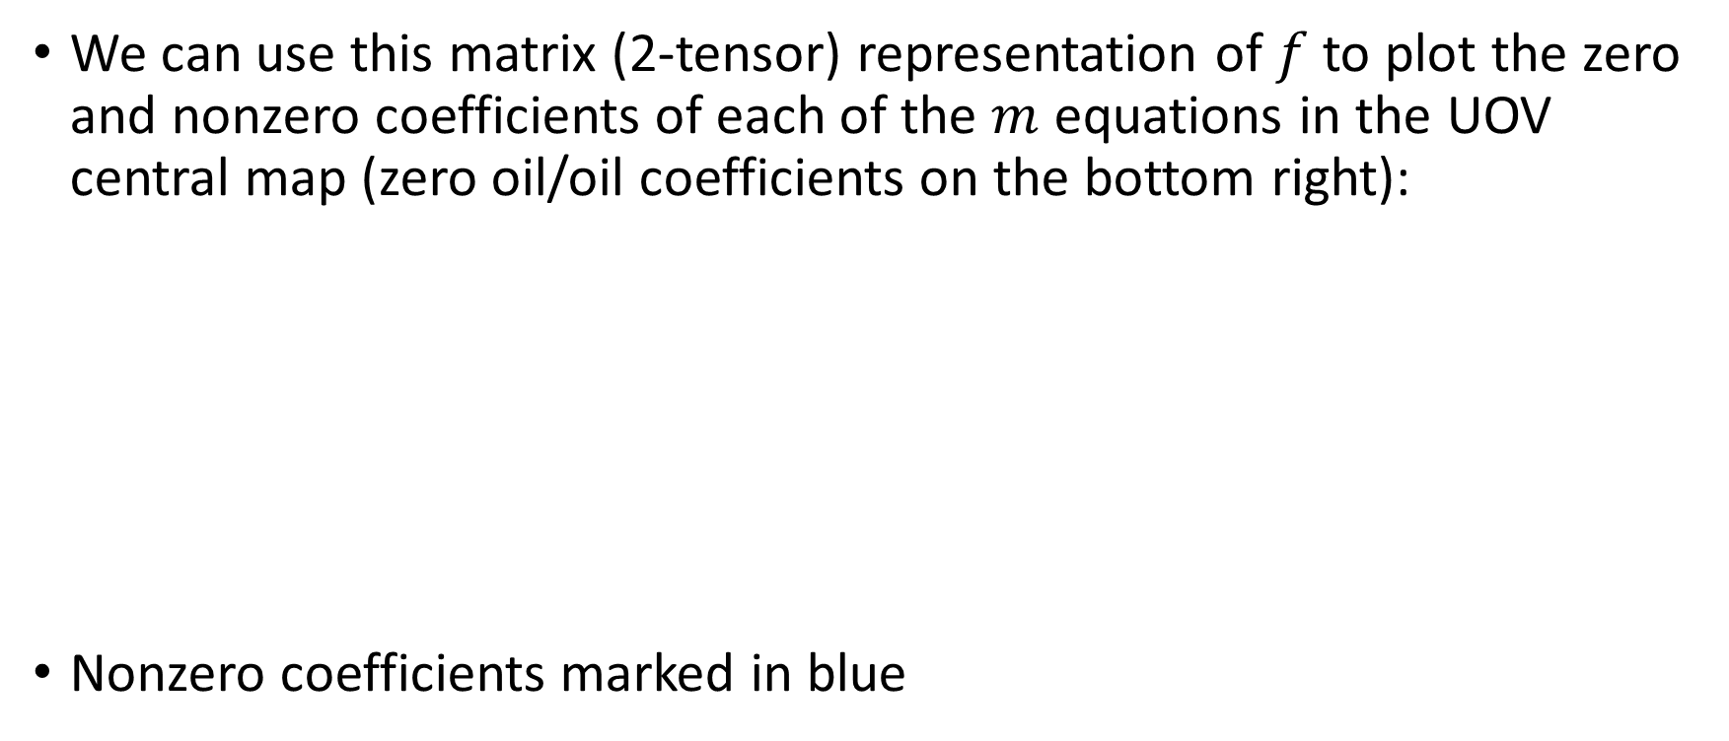

Matrix Representation of $f$
We can use this matrix (2-tensor) representation of $f$ to plot the zero and nonzero coefficients of each of the $m$ equations in the UOV central map (zero oil/oil coefficients on the bottom right):
Nonzero coefficients marked in blue

Slide 11
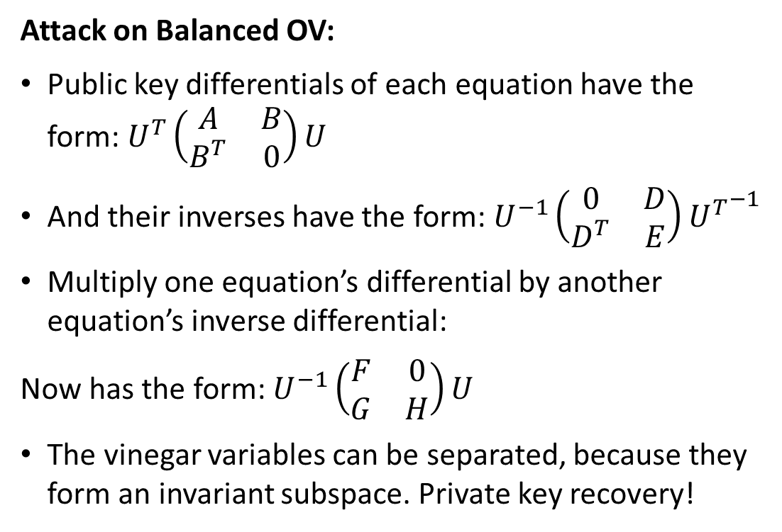
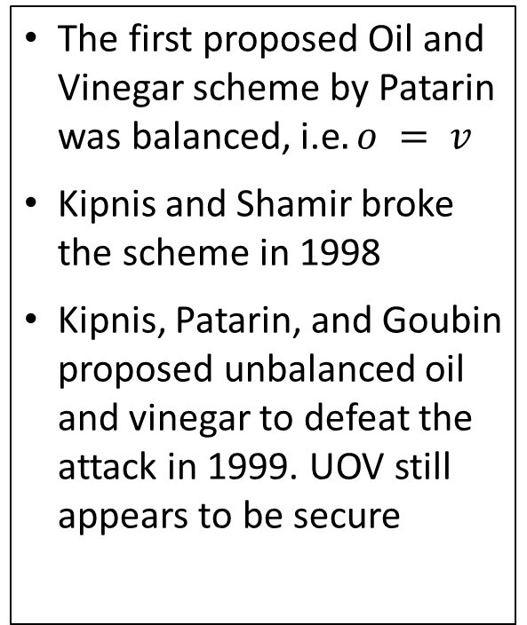
Why Unbalanced?
Attack on Balanced OV:
Public key differentials of each equation have the form: $U^{T}\left(\begin{matrix}A & B \\ B^{T} & 0\end{matrix}\right)U$
And their inverses have the form: $U^{−1}\left(\begin{matrix}0 & D \\ D^{T} & E\end{matrix}\right){U^{T}}^{−1}$
Multiply one equation’s differential by another equation’s inverse differential:
Now has the form: $U^{−1}\left(\begin{matrix}F & 0 \\ G & H\end{matrix}\right)U$
The vinegar variables can be separated, because they form an invariant subspace. Private key recovery!
The first proposed Oil and Vinegar scheme by Patarin was balanced, i.e$. o = v$
Kipnis and Shamir broke the scheme in 1998
Kipnis, Patarin, and Goubin proposed unbalanced oil and vinegar to defeat the attack in 1999. UOV still appears to be secure

Slide 12
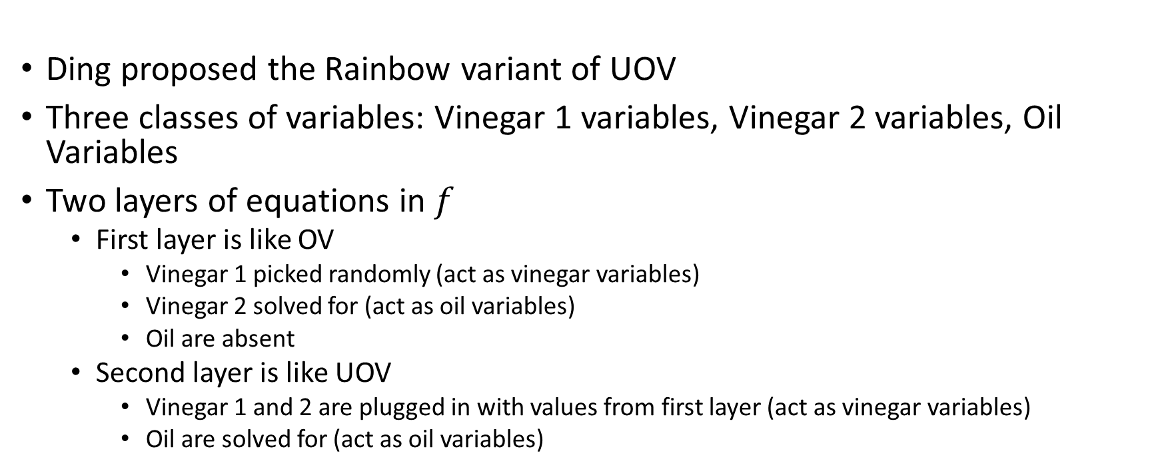
Rainbow
Ding proposed the Rainbow variant of UOV
Three classes of variables: Vinegar 1 variables, Vinegar 2 variables, Oil Variables
Two layers of equations in $f$
  First layer is like OV
    Vinegar 1 picked randomly (act as vinegar variables)
    Vinegar 2 solved for (act as oil variables)
    Oil are absent
  Second layer is like UOV
    Vinegar 1 and 2 are plugged in with values from first layer (act as vinegar variables)
    Oil are solved for (act as oil variables)

Slide 13
Attacks on Rainbow
The Rainbow submission analyzed 5 attacks:
  Direct attack, MinRank attack, HighRank attack, UOV attack, Rainbow Band Separation (RBS) attack
Developments in Round 2
  The complexity of the MinRank attack was dramatically reduced by the Support Minors technique for solving the generic MinRank problem
    This did not break any Rainbow parameter set, though
  The complexity of the RBS attack was reduced slightly by (Perlner, Smith-Tone 2020)
    Previous experimental evidence from (Thomae 2012) suggested that RBS attack is cheaper than existing analysis indicated for small parameters
    Perlner, Smith-Tone explained these experiments and generalized to all parameters
    Since RBS was the best attack for several parameter sets, this prompted a readjustment of parameters

Slide 14
Attacks on Rainbow
Developments in Round 3
  Beullens proposed a new way to use MinRank to attack Rainbow
    This reduced the security of the new (and old) parameter sets a modest amount
  Rather than adjust their parameters again, the Rainbow team argued they still met their security targets due to memory costs
    Ongoing analysis suggests that a proper accounting of memory costs likely increases the complexity of both the old and new attacks, but not enough for Rainbow’s parameter sets to meet security targets

Slide 15

Support Minors
Method for Solving MinRank
MinRank definition:
  Given $K$ matrices of dimension $m×n$ over a (finite) field $F_{q}$, find a linear combination with rank $r$

Slide 16
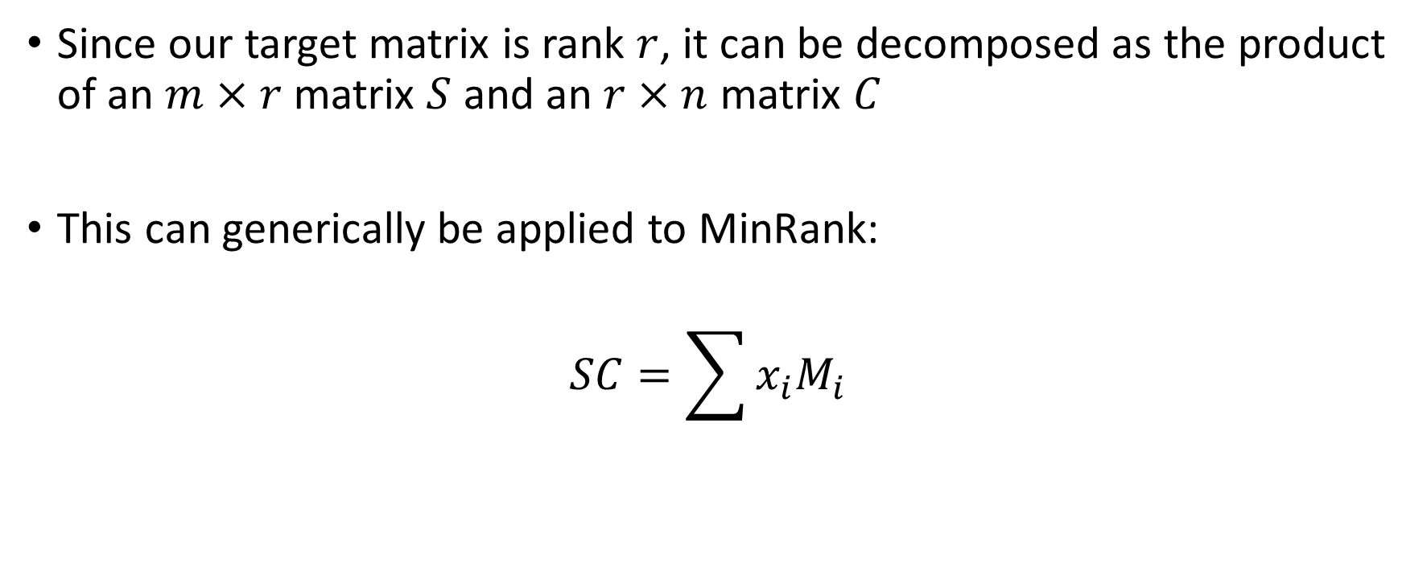
Rank Decomposition Modeling
[Bardet, Bros, Cabarcas, Gaborit, Perlner, Smith-Tone, Tillich, Verbel 2020]
Since our target matrix is rank $r$, it can be decomposed as the product of an $m×r$ matrix $S$ and an $r×n$ matrix $C$
This can generically be applied to MinRank:
$$SC=\sum{x_{i}M_{i}}$$

Slide 17
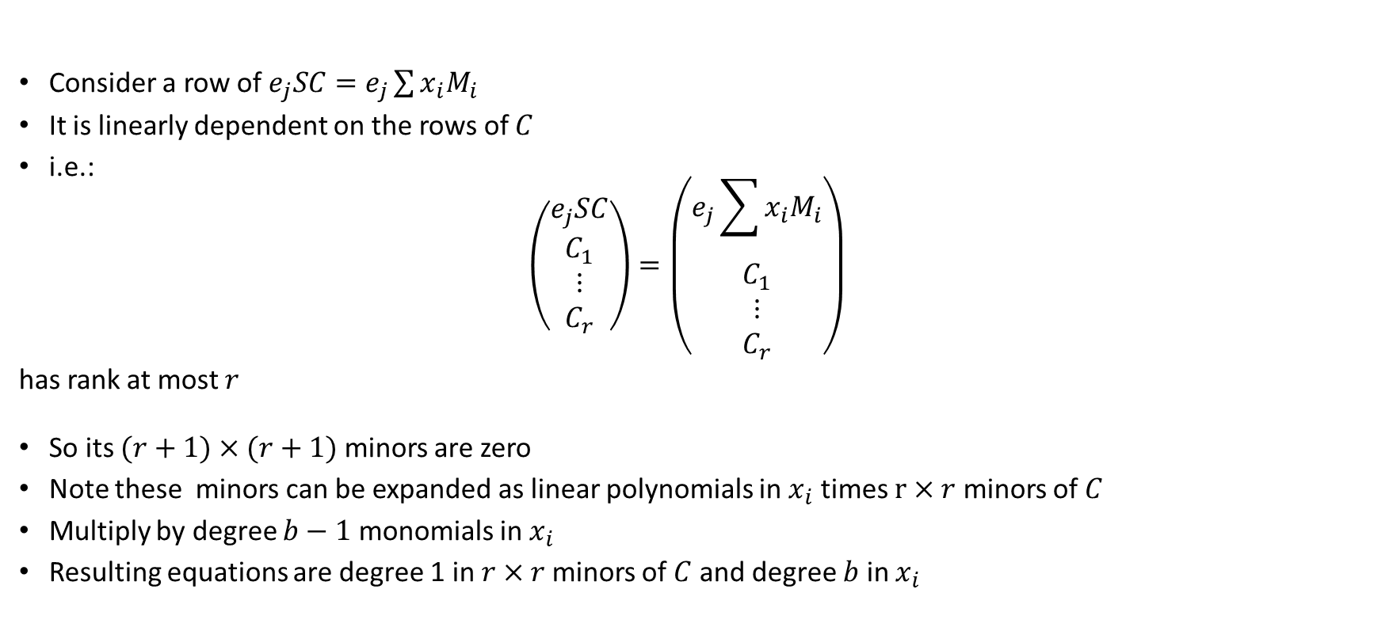
Support Minors Modeling
[Bardet, Bros, Cabarcas, Gaborit, Perlner, Smith-Tone, Tillich, Verbel 2020]
Consider a row of $e_{j}SC=e_{j}\sum{x_{i}M_{i}}$
It is linearly dependent on the rows of $C$
i.e.:
$$\left(\begin{matrix}\begin{matrix}e_{j}SC \\ C_{1}\end{matrix} \\ \begin{matrix}⋮ \\ C_{r}\end{matrix}\end{matrix}\right)=\left(\begin{matrix}\begin{matrix}e_{j}\sum{x_{i}M_{i}} \\ C_{1}\end{matrix} \\ \begin{matrix}⋮ \\ C_{r}\end{matrix}\end{matrix}\right)$$
has rank at most $r$
So its $(r+1)×(r+1)$ minors are zero
Note these minors can be expanded as linear polynomials in $x_{i}$ times $r×r$ minors of $C$
Multiply by degree $b−1$ monomials in $x_{i}$
Resulting equations are degree 1 in $r×r$minors of $C$ and degree $b$ in $x_{i}$

Slide 18
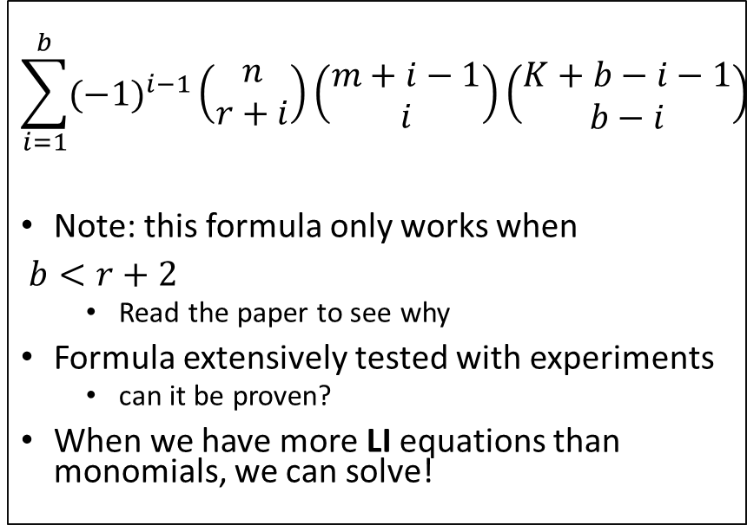
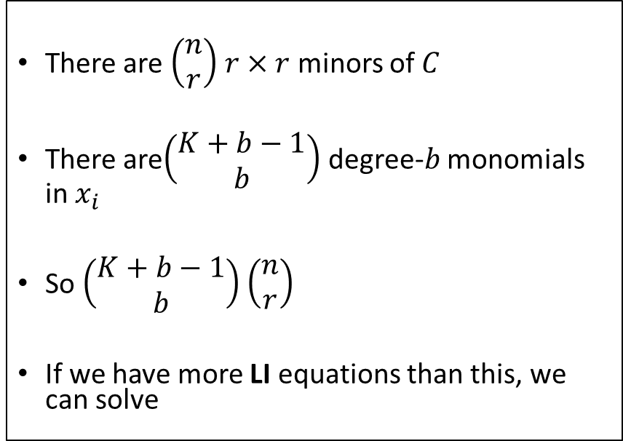
Support Minors Modeling – How Many:
Monomials?
Linearly Independent (LI) Equations?
There are $\left(\begin{matrix}n \\ r\end{matrix}\right)$ $r×r$ minors of $C$
There are$\left(\begin{matrix}K+b−1 \\ b\end{matrix}\right)$ degree-$b$ monomials in $x_{i}$
So $\left(\begin{matrix}K+b−1 \\ b\end{matrix}\right)$ $\left(\begin{matrix}n \\ r\end{matrix}\right)$
If we have more LI equations than this, we can solve
$$\sum_{i=1}^{b}{({−1)}^{i−1}\left(\begin{matrix}n \\ r+i\end{matrix}\right)\left(\begin{matrix}m+i−1 \\ i\end{matrix}\right)\left(\begin{matrix}K+b−i−1 \\ b−i\end{matrix}\right)}$$
Note: this formula only works when
$b<r+2$
  Read the paper to see why
Formula extensively tested with experiments
  can it be proven?
When we have more LI equations than monomials, we can solve!

Slide 19
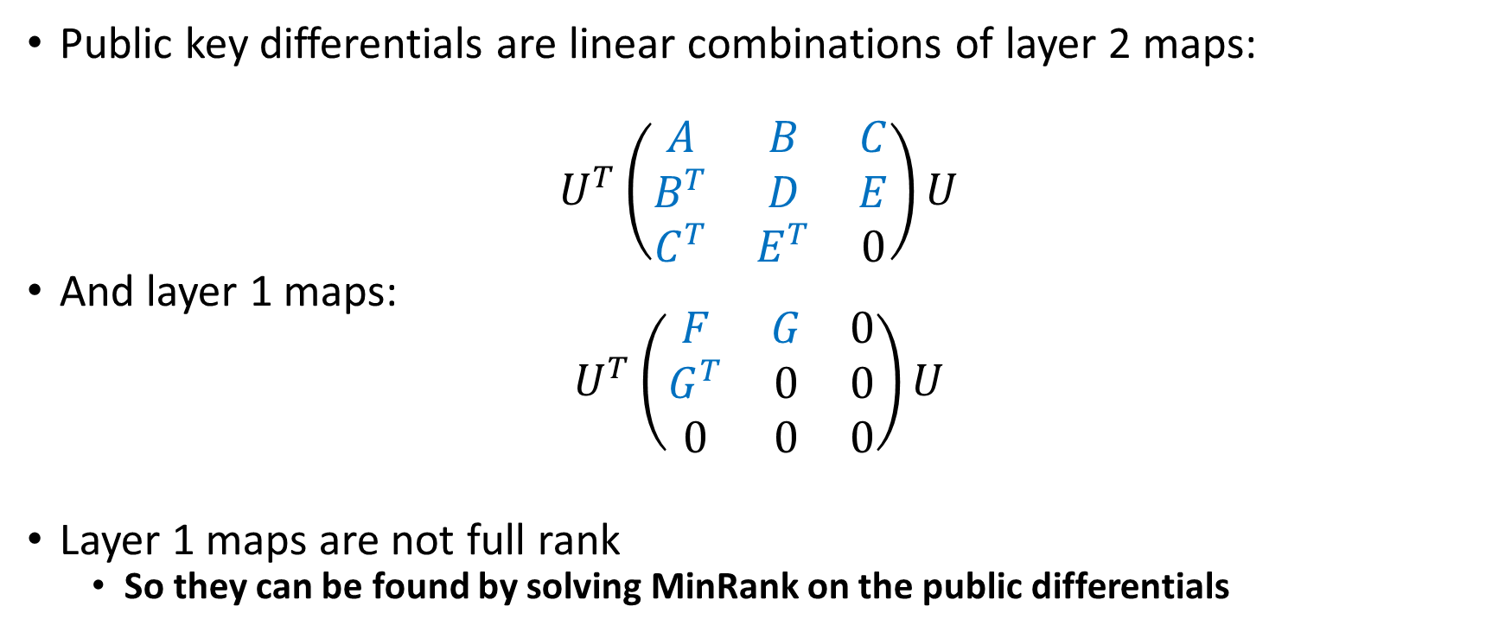
Old MinRank Attack on Rainbow
Public key differentials are linear combinations of layer 2 maps:
$$U^{T}\left(\begin{matrix}A & B & C \\ B^{T} & D & E \\ C^{T} & E^{T} & 0\end{matrix}\right)U$$
And layer 1 maps:
$$U^{T}\left(\begin{matrix}F & G & 0 \\ G^{T} & 0 & 0 \\ 0 & 0 & 0\end{matrix}\right)U$$
Layer 1 maps are not full rank
  So they can be found by solving MinRank on the public differentials

Slide 20
Effect of Support Minors on MinRank Complexity of Old MinRank Attack

Slide 21
RBS is Better than We Thought
(Perlner, Smith Tone 2020)
RBS is an algebraic (equation solving) key recovery attack proposed in (Ding et. al 2008)
(Thomae 2012) included experimental data indicating the RBS equations are easier to solve with Grobner Basis Software than generic systems
Perlner, Smith-Tone explain this by noting that there are two different variable types which can be treated differently in order to solve the system with a lower complexity
Net effect:

Slide 22
Round 3 Developments
The Rainbow team tweaked their parameters to respond to the RBS attack improvement
Beullens proposed a new way to use MinRank to attack Rainbow– this reduced the security of the new (and old) parameter sets a modest amount
Rather than adjust their parameters again, the Rainbow team argued they still met their security targets due to memory costs
  Ongoing analysis suggests that a proper accounting of memory costs likely increases the complexity of both the old and new attacks, but not enough to meet security targets

Slide 23
Reminder: Old MinRank attack on Rainbow
Public key differentials are linear combinations of layer 2 maps:
$$U^{T}\left(\begin{matrix}A & B & C \\ B^{T} & D & E \\ C^{T} & E^{T} & 0\end{matrix}\right)U$$
And layer 1 maps:
$$U^{T}\left(\begin{matrix}F & G & 0 \\ G^{T} & 0 & 0 \\ 0 & 0 & 0\end{matrix}\right)U$$
Layer 1 maps are not full rank
  So they can be found by solving MinRank on the public differentials

Slide 24
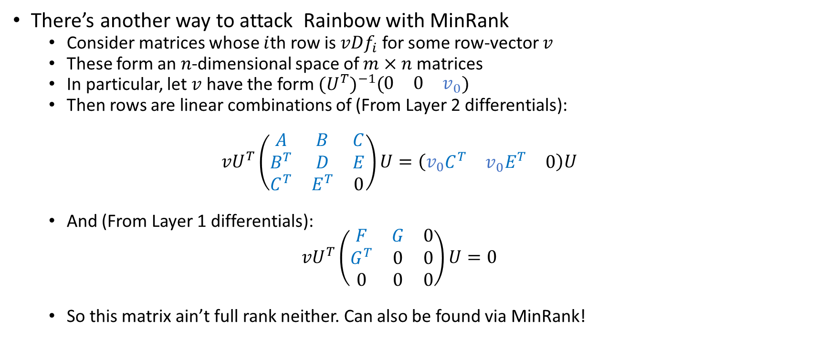
Ward Beullens Rectangular MinRank Attack
(https://eprint.iacr.org/2020/1343)
There’s another way to attack Rainbow with MinRank
  Consider matrices whose $i$th row is $vDf_{i}$ for some row-vector $v$
  These form an $n$-dimensional space of $m×n$ matrices
  In particular, let $v$ have the form ${{(U}^{T})}^{−1}\left(\begin{matrix}0 & 0 & v_{0}\end{matrix}\right)$
  Then rows are linear combinations of (From Layer 2 differentials):
  $${vU}^{T}\left(\begin{matrix}A & B & C \\ B^{T} & D & E \\ C^{T} & E^{T} & 0\end{matrix}\right)U=\left(v_{0}\begin{matrix}C^{T} & {v_{0}E}^{T} & 0\end{matrix}\right)U$$
  And (From Layer 1 differentials):
  $${vU}^{T}\left(\begin{matrix}F & G & 0 \\ G^{T} & 0 & 0 \\ 0 & 0 & 0\end{matrix}\right)U=0$$
  So this matrix ain’t full rank neither. Can also be found via MinRank!

Slide 25
Beullens’s Attack Quantitatively

Slide 26
But Memory!
(https://troll.iis.sinica.edu.tw/by-publ/recent/response-ward.pdf)
Rather than tweak parameters again, the Rainbow team posted a note claiming they still meet the NIST security targets if you account for memory costs. Their estimates were:

Slide 27
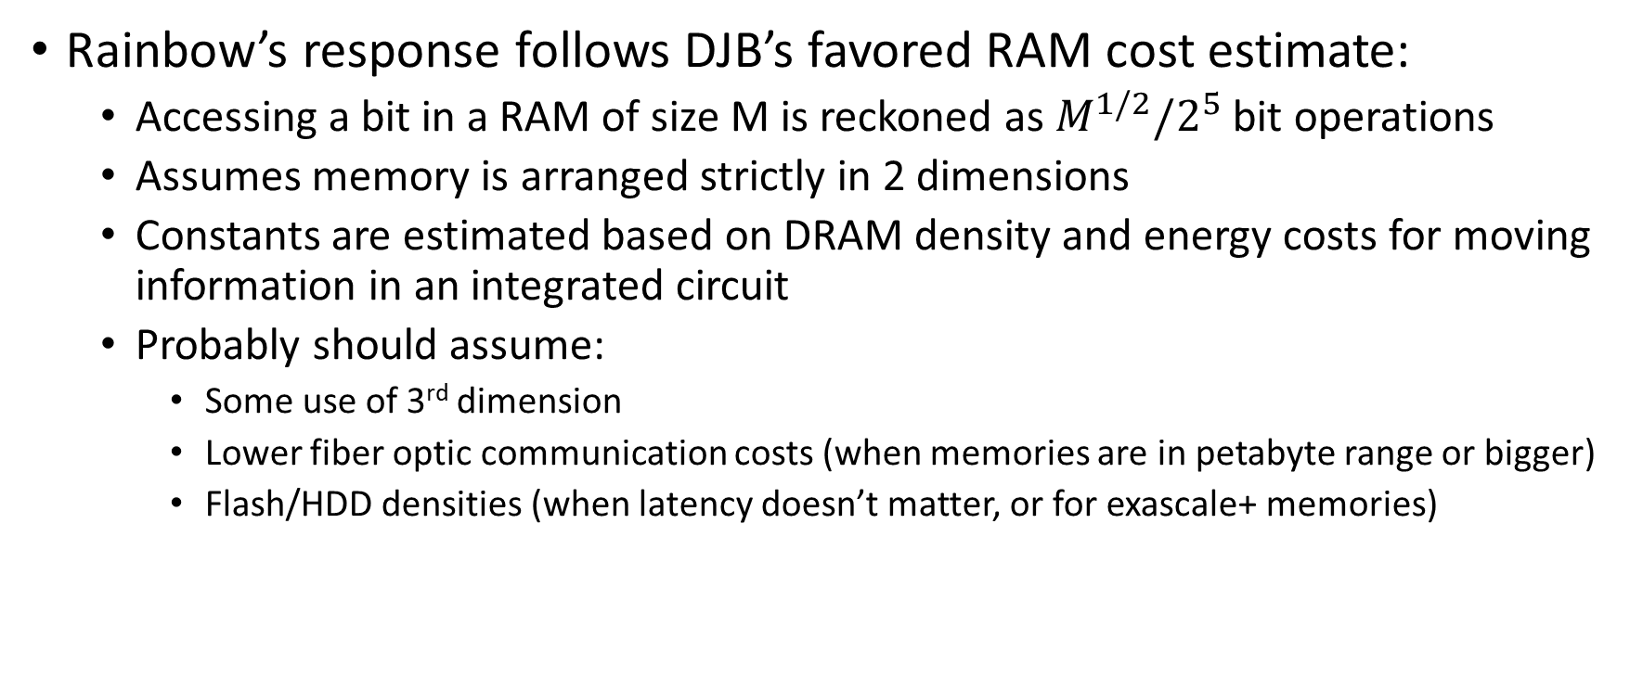
But Memory!
Questionable assumptions
Rainbow’s response follows DJB’s favored RAM cost estimate:
  Accessing a bit in a RAM of size M is reckoned as $M^{1/2}/2^{5}$ bit operations
  Assumes memory is arranged strictly in 2 dimensions
  Constants are estimated based on DRAM density and energy costs for moving information in an integrated circuit
  Probably should assume:
    Some use of 3rd dimension
    Lower fiber optic communication costs (when memories are in petabyte range or bigger)
    Flash/HDD densities (when latency doesn’t matter, or for exascale+ memories)

Slide 28
But Memory!
Is it Really Random Access?
Can we use structure of the problem to make memory access more local?
  Analyzed in the same in-progress paper where we (Baena, Briaud, Cabarcas, Perlner, Smith-Tone Verbel) improve the GeMSS attack.
  Through some combination of
    arranging memory so that data can be processed mostly locally
    caching memory that’s used multiple times
    blocking data together to avoid sending addresses
  We reduce estimated cost (even following DJB’s memory cost estimates) to:

Slide 29
Performance (Sizes)

Slide 30
Performance (Speed)

Slide 31
Rainbow Summary
Rainbow is a Finalist Signature scheme that offers:
  Huge public keys (even with compression)
  Small signatures
  Fast verification (with the uncompressed key)
Rainbow is a little bit broken
  The flurry of attacks in the 2nd/3rd round may bring the maturity of Rainbow into question
    The current best attack looks structurally pretty different from what was believed to be the best attack in Round 1
  Or the fact that the security moved only a little could be encouraging
    Seems like parameters that are strong against previously known attacks are also fairly good against the new ones

Slide 32
Options:
Let’s Discuss
Standardize Rainbow Now!
  Would need to downgrade existing parameters claimed security and drop category I parameters
  Probably don’t want to do this, but wouldn’t be completely crazy
Make Rainbow an Alternate
  Are we keeping any Alternate signatures for a 4th Round? Or is everything OnRamp after round 3?
Pre-admit Rainbow to OnRamp
Give Rainbow no official status (remove current submission from consideration)
  but suggest it be submitted to OnRamp
  OR actively discourage from submitting it to OnRamp

Slide 33
References
Support Minors: https://hal.archives-ouvertes.fr/hal-02475356v3/document
RBS Better than we Thought: https://eprint.iacr.org/2020/702
Rectangular MinRank: https://eprint.iacr.org/2020/1343
  Rainbow Response: https://troll.iis.sinica.edu.tw/by-publ/recent/response-ward.pdf
Older References on RBS:
  RBS Original Paper: https://eprint.iacr.org/2008/108.pdf
  Thomae (includes RBS experiments): https://eprint.iacr.org/2012/223.pdf

